Slide 1
Chapter 6 RTL Design (Ref- Frank Wahid ch-5) EXTC – TE – DVLSI Swati Rane Assistant Professor Dept. of Electronics and Telecommunication SIES Graduate School of Technology
DVLSI

Slide 2
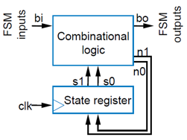
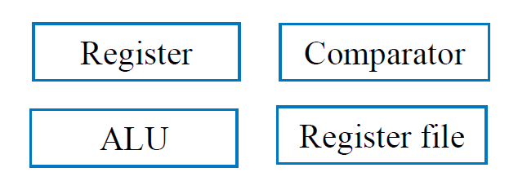
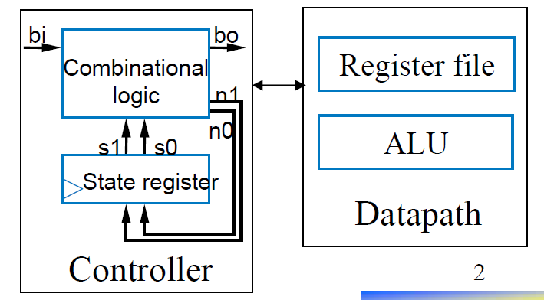
RTL Design- Introduction
Processors:
Programmable
Custom designed (non-programmable)
Custom Processor: perform a particular task using
Controllers
Control input/output: single bit (or just a few) representing event or state
Finite-state machine describes behavior; implemented as state register and combinational logic
Datapath components
Data input/output: Multiple bits collectively representing single entity
Datapath components included registers, adders, ALU, comparators, register files, etc.

Slide 3
Register-transfer level (RTL) is a design abstraction which models a custom processor (synchronous digital circuit) in terms of
the flow of digital signals (data) between hardware registers, and
the logical operations performed on those signals.
RTL Design:
Specifies the registers of a design
Describes the possible transfers and operations performed on input, output and register data
Defines the control that specifies when to transfer and operate on data.

Slide 4
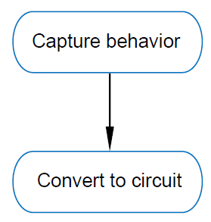
RTL design
Review
Combinational Logic Design
First step: Capture behavior (using equation or truth table)
Remaining steps: Convert to circuit
Sequential Logic Design
First step: Capture behavior (using FSM)
Remaining steps: Convert to circuit
RTL design
First step: Capture behavior (using high level state machine).
Remaining steps: Convert to circuit.

Slide 5
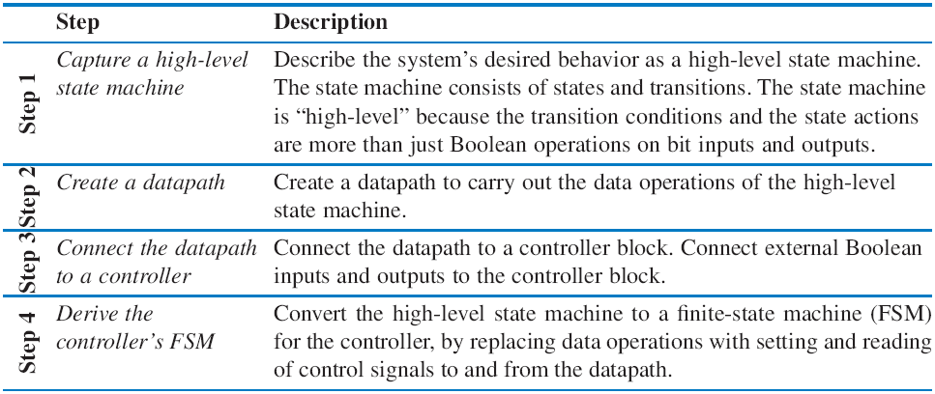
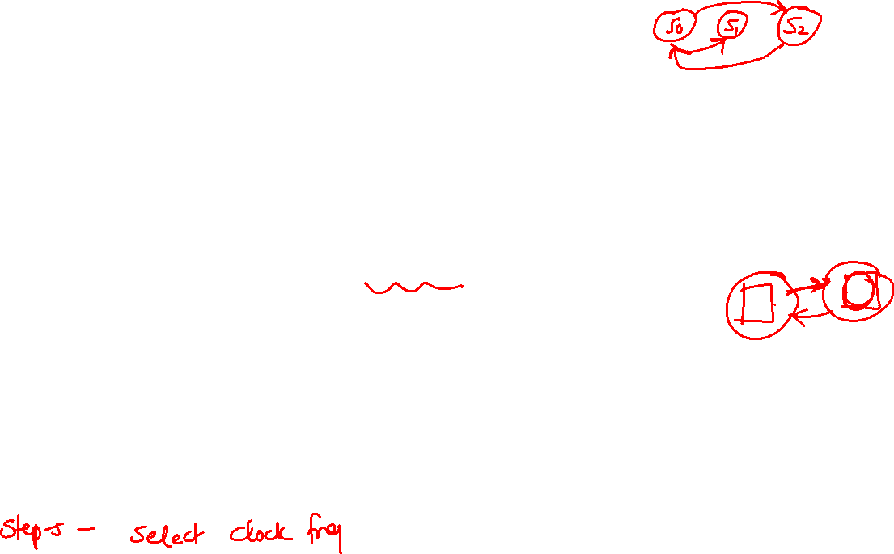
RTL Design Process

Slide 6

High Level State Machines
FSM is not sufficient for capturing the data aspects of the system behavior
FSM consists of inputs, outputs(limited to Boolean types), states, state actions (limited to Boolean equations), state transition (limited to Boolean expressions)
High level state machines can be used to capture more complex logic involving multi-bit variables
High Level State Machines (HLSM) extend FSMs with features that make it possible to capture more complex behaviors.
Multi-bit data inputs and outputs
Assumed unsigned unless specified as signed
Local storage
Registers loaded on rising clock edges (i.e. when leaving a state)
Arithmetic operations
Add, Multiply, Compare, Bit Shift, etc

Slide 7

HLSM Conventions
All inputs, outputs and local storage are defined at the top of the HLSM diagram
Bit lengths are included in this definition
All outputs are registered.
Local storage values are always registered.
Registered values change on rising clock edges (i.e. when leaving a state)
Transition bits are implicitly ANDed with rising clock edge
Any unregistered output not explicitly assigned is 0.
Any registered value not explicitly assigned holds it’s value.

Slide 8
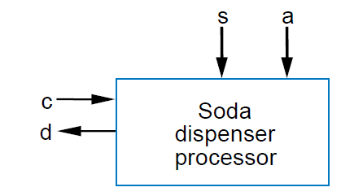
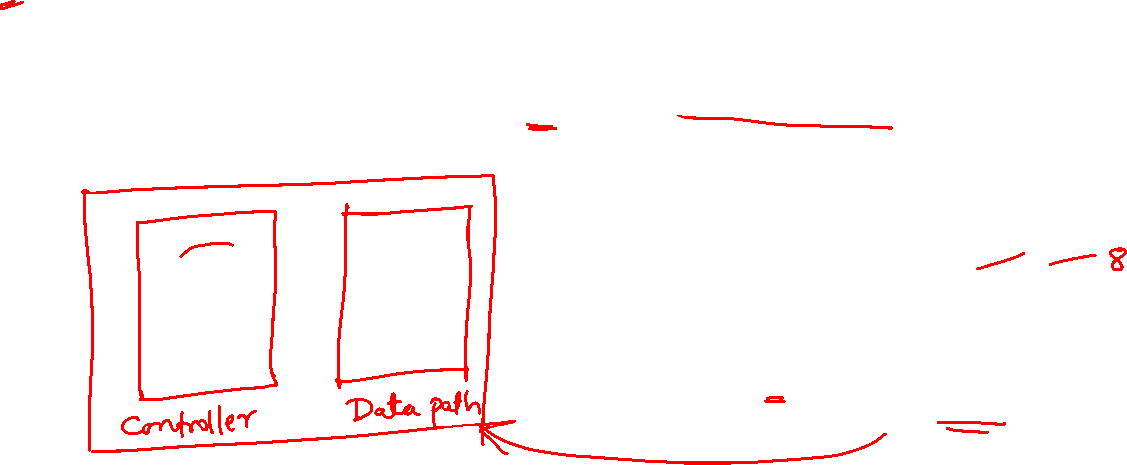
Soda dispenser Machine
c: bit input, 1 when coin deposited.
a: 8-bit input having value of deposited coin.
s: 8-bit input having cost of a soda.
d: bit output, processor sets to 1 when total value of deposited coins equals or exceeds cost of a soda.

Slide 9
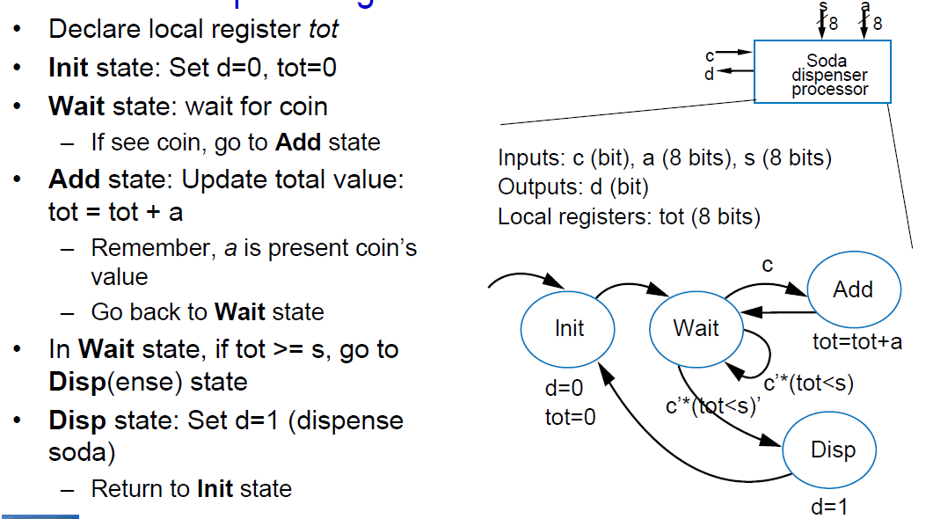
Step 1-Capture High Level FSM

Slide 10
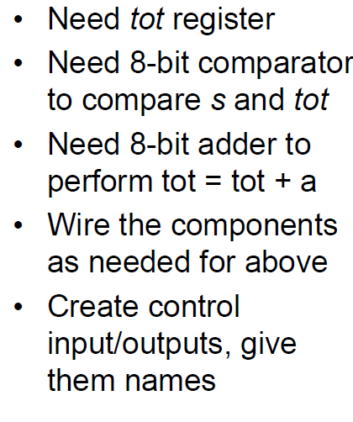
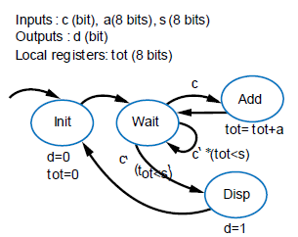
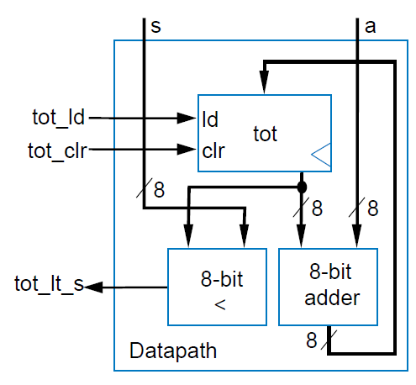
Step2- Create Data Path

Slide 11
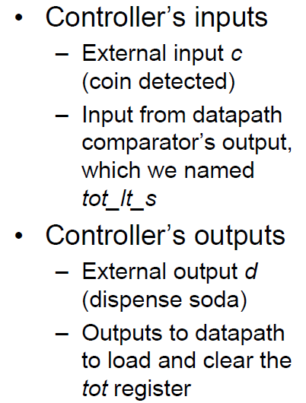
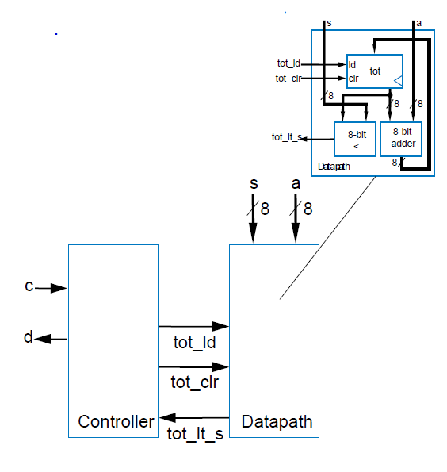
Step 3-Create Data path to controller

Slide 12
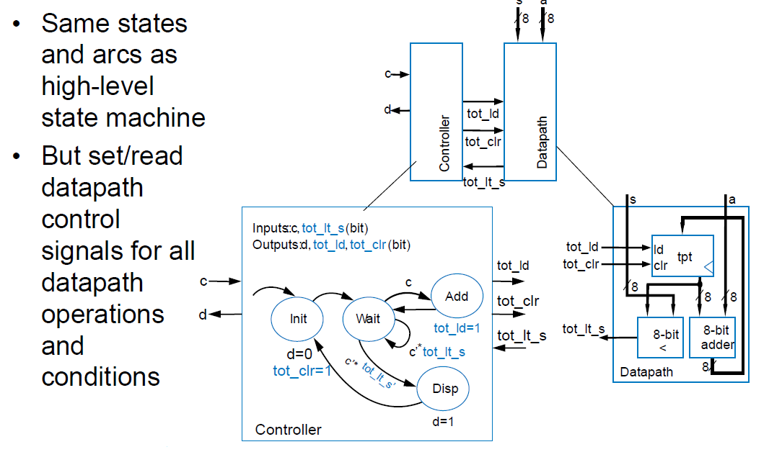
Derive Controllers FSM

Slide 13
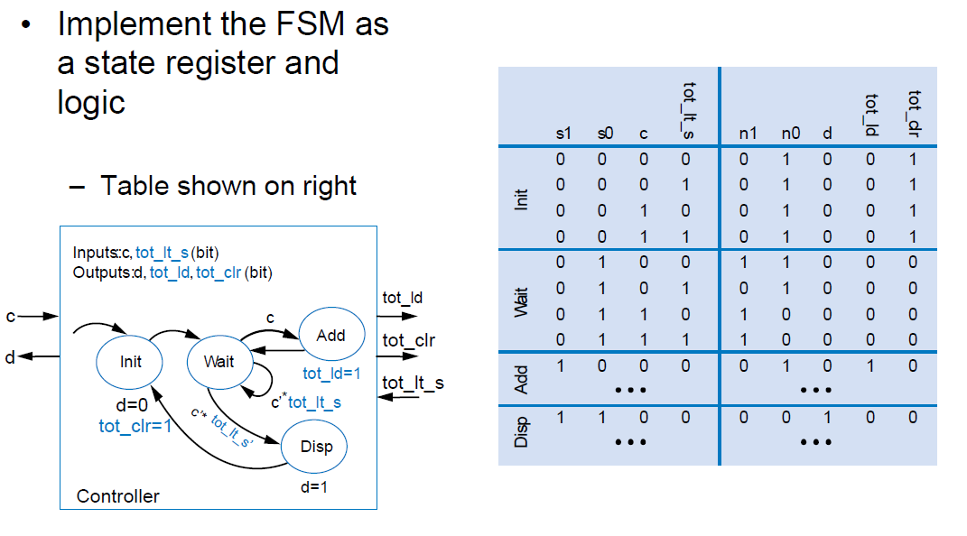
Completing Design

Slide 14
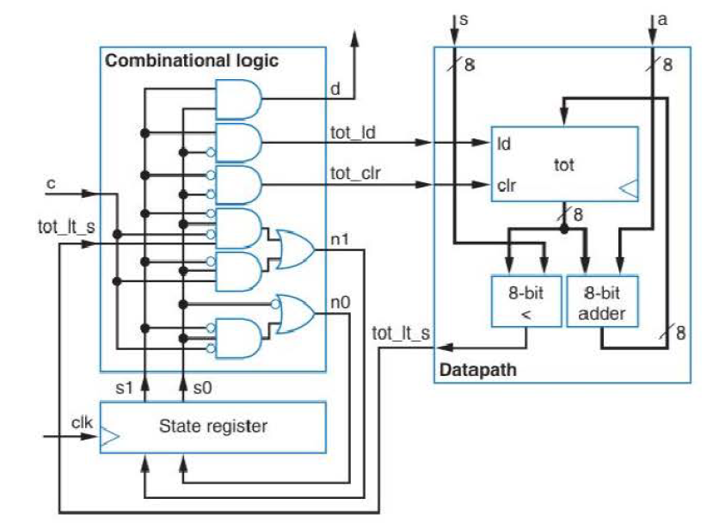
Final Implementation

Slide 15
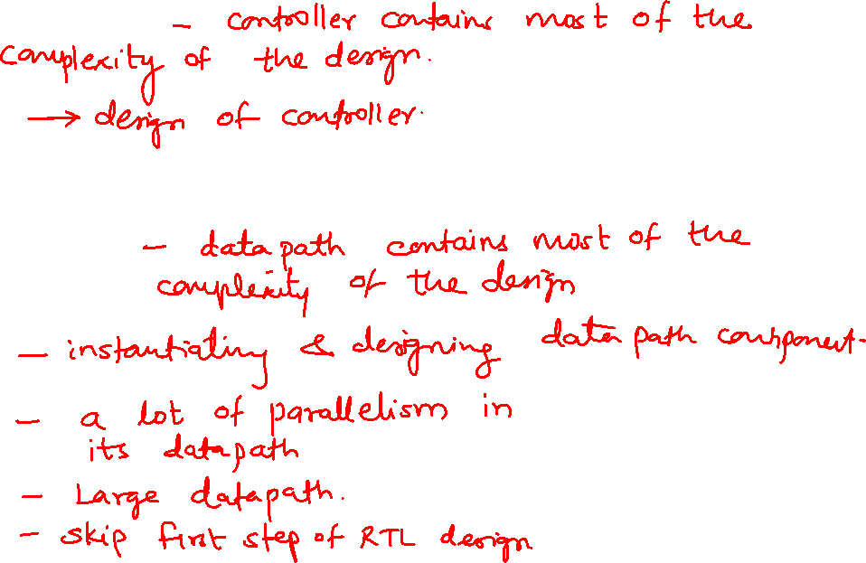
RTL Designs categories
Control-dominated design
Data-dominated design

Slide 16
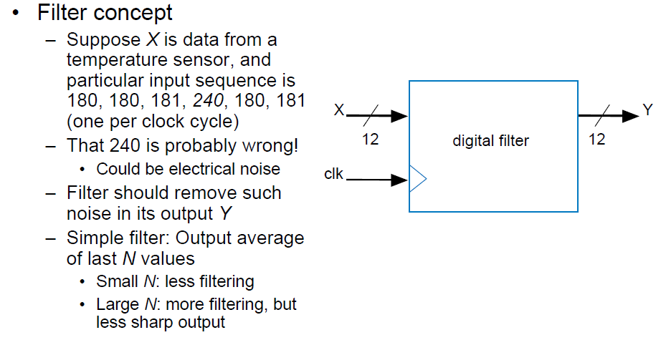
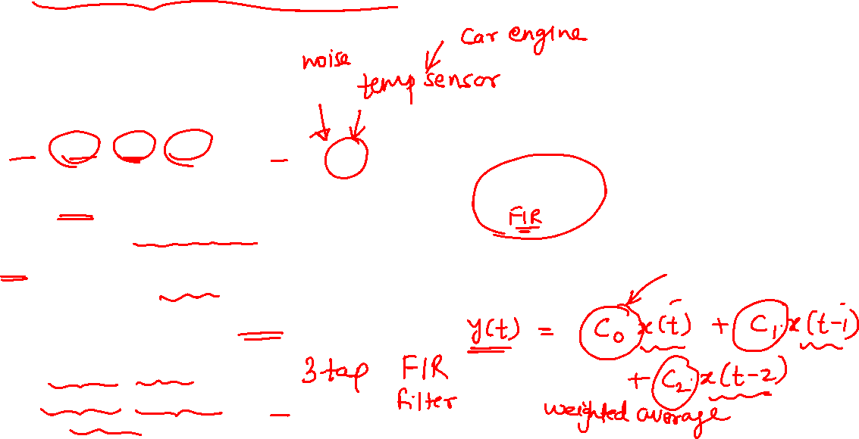
Data Dominated RTL Design Example: FIR Filter

Slide 17
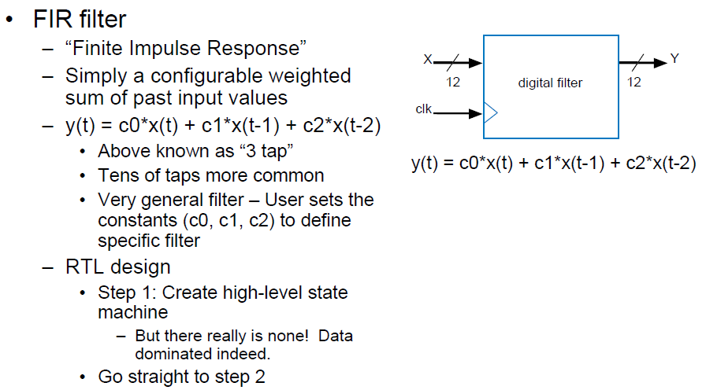


Slide 18
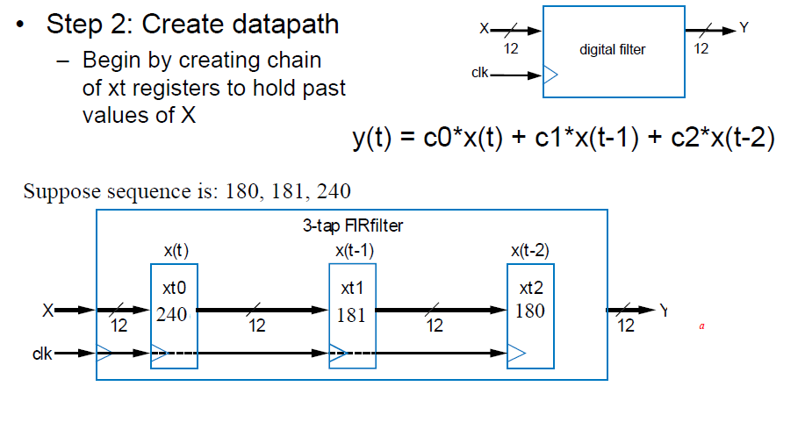
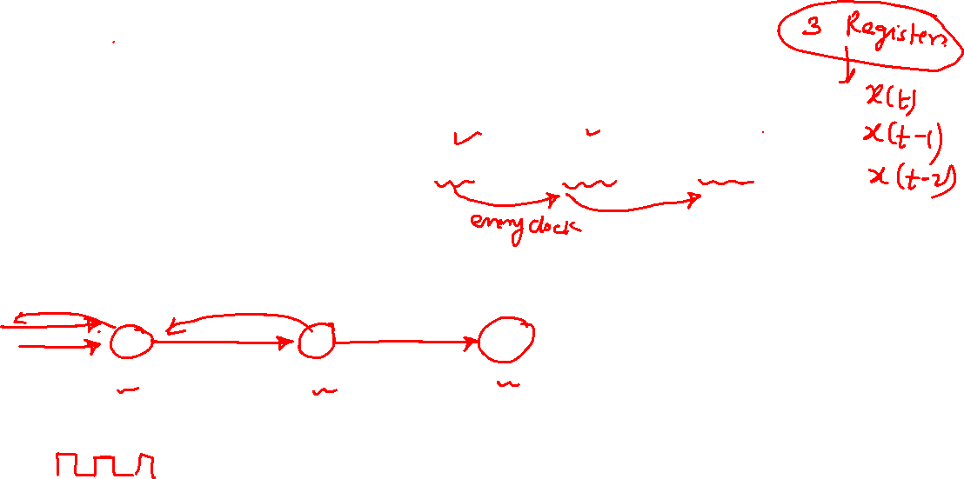

Slide 19
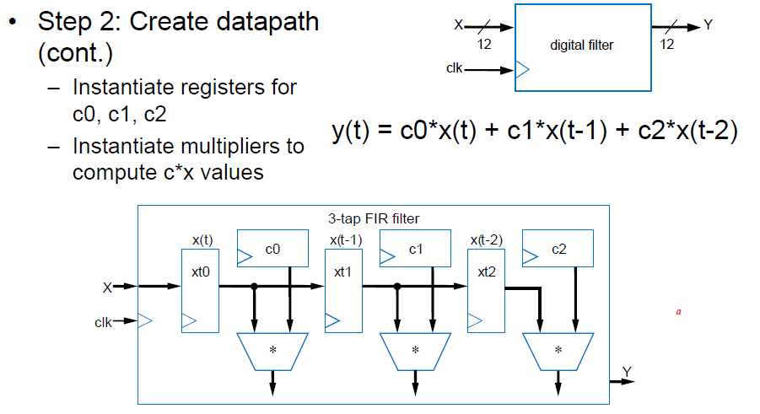
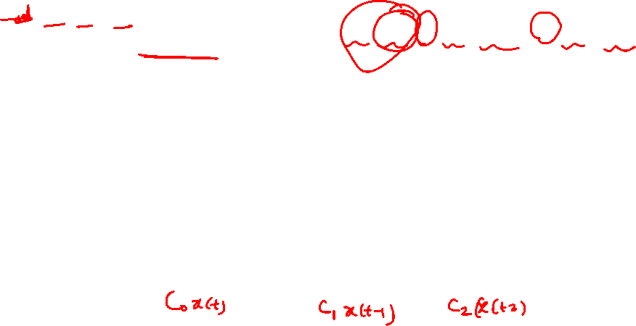

Slide 20
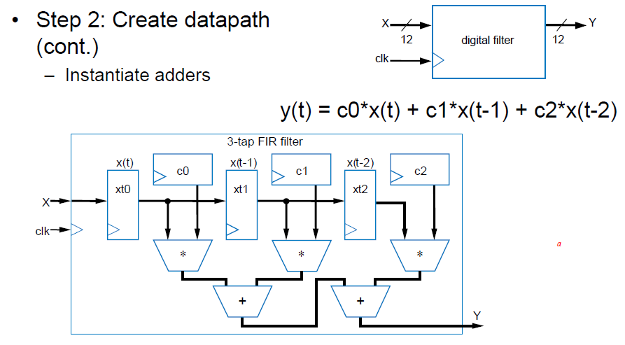


Slide 21
